Slide 1
C in Automotive Software Development
Central error memory
Faizan Mahmood

Slide 2
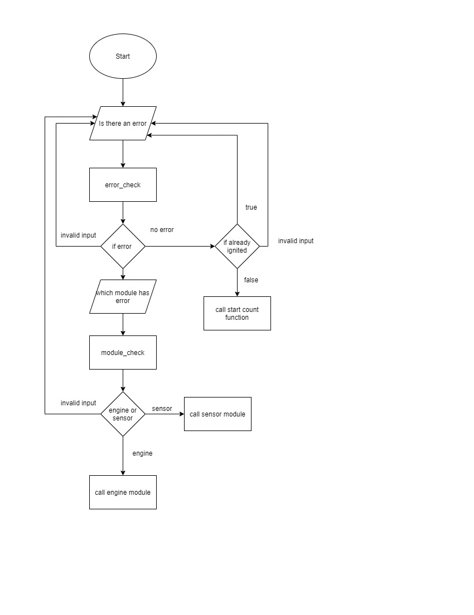
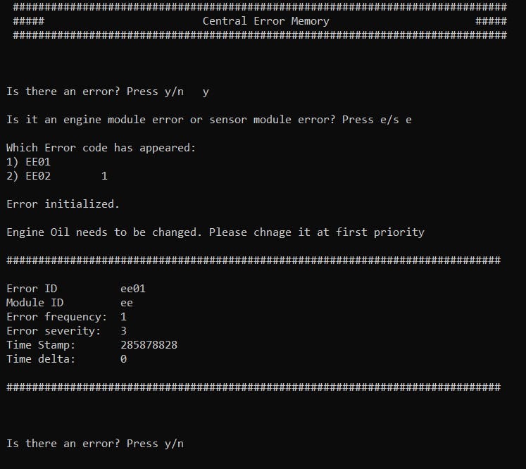
Central error memory
Problem Introduction
Solution Methodology
Future Advancement
Parameters
Module ID
Error ID
Severity
Time Stamp
Time Delta
Error Frequency
Severity
Information
Low
Medium
High
Critical

